Slide 2
UNIT-1 Overview of Computer organization and Programming fundamentals

Slide 3
Objective : UNIT-1
After completion of Unit-1, students will be able
To understand the concepts of Computer System Organization
To understand the evolution of programming languages
To recognize the basics of programming environment
To demonstrate the fundamental concepts of programming language.

Slide 4
Computer System
Computer is not a computer but a system : Computer System
A Computer system is an electronic machine that takes raw data as input from the input devices (mouse, keyboard, joystick etc.), processes data with processing unit (ALU, CU & Memory Units) and gives output with the help of Output units(Monitor, Printer etc) and also saves output for the future use.
PROCESSING
INPUT
OUTPUT

Slide 5
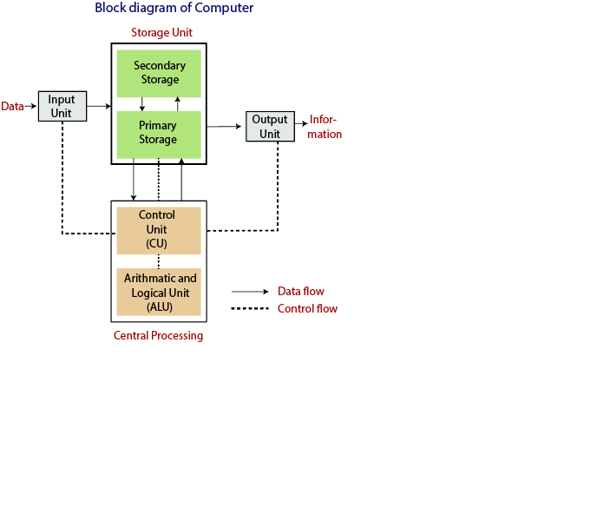
Block Diagram of Computer System

Slide 6
Components of Computer System
Input Devices - Keyboards, mouse, scanners, digital cameras, joysticks & microphones
Processing Unit : Central Processing Unit(ALU, CU)
Output Devices : Monitor, Printer, Graphic Output devices, Plotters, speaker etc.
Memory & Storage Devices :-
Hard drive – An internal hard drive is the main storage device in a computer.
Magnetic strip – Magnetic tape drive stores video and audio using magnetic tape, like tape and video tape recorders

Slide 7
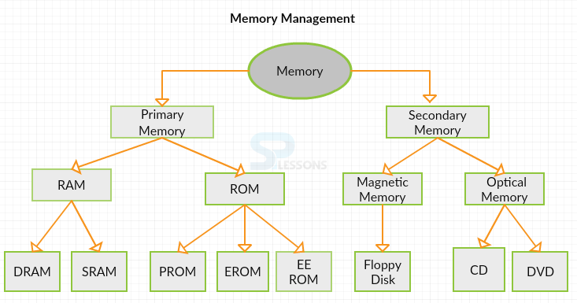
Types of Memory Unit
Notes:
RAM :- Random Access Memory
ROM :- Read Only Memory
DRAM :- Dynamic random-access memory- type of random access semiconductor memory that stores each bit of data in a memory cell consisting of a tiny capacitor and a transistor, both typically based on metal-oxide-semiconductor (MOS) technology.
SRAM :- Static random-access memory- is a type of random-access memory (RAM) that uses latching circuitry (flip-flop) to store each bit. SRAM is volatile memory; data is lost when power is removed.
PROM:- A programmable read-only memory - is a form of digital memory where the setting of each bit is locked by a fuse or antifuse.
ERPM / EPROM :- An EPROM (rarely EROM), or erasable programmable read only memory, is a type of memory chip that retains its data when its power supply is switched off. It is non-volatile.
EEROM :- Electrically Erasable Programmable Read-Only Memory -is a type of non-volatile memory used in computers and other electronic devices to store small amounts of data. It can be erased and reprogrammed through the application of electrical charge.

Slide 8
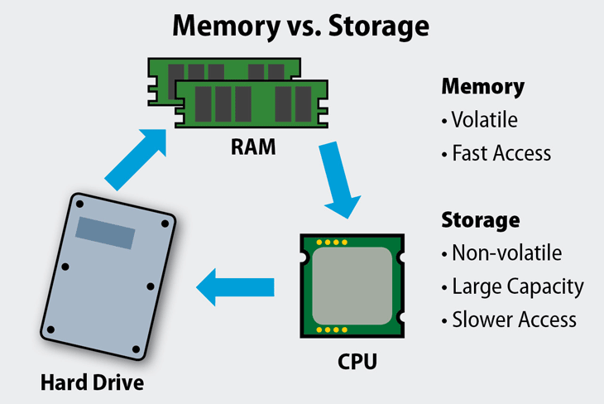
Memory vs Storage
Notes:
RAM is volatile memory, which means that the information temporarily stored in the module is erased when you restart or shut down your computer. Because the information is stored electrically on transistors, when there is no electric current, the data disappears.

Slide 9
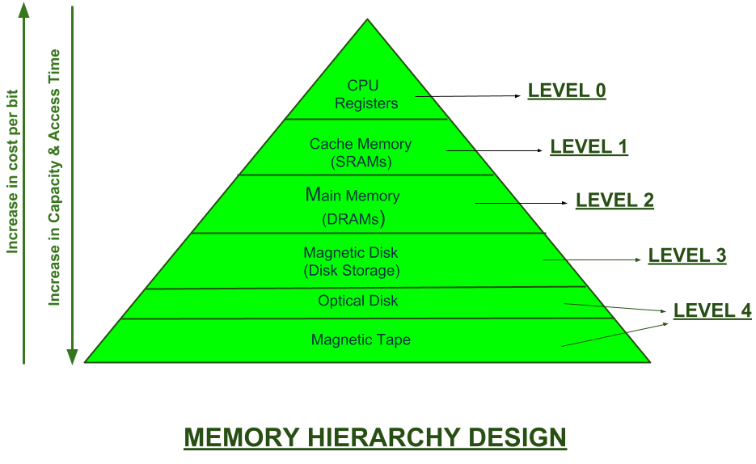
Memory Hierarchy
Computer Memory can be divided into 4 categories:
CPU register
Cache memory
Primary / Main memory
Secondary Memory / Mass Storage
Notes:
In computer architecture, the CPU register holds the key role which is small data holding place or memory, and is an integral part of the processor. It is a very fast memory of computer mainly used to execute the programs and other main operation quite efficiently. Register basically used to quickly store, accept, transfer, and operate on data based on the instructions that will be immediately used by the CPU. In memory hierarchy of a computer registers the top place and is fastest in manipulating the data.
Accumulator (AC)
Flag Register
Address Register (AR)
Data Register (DR)
Program Counter (PC)
Instruction Register (IR)
Stack Control Register (SCR)
Memory Buffer Register (MBR)
Index register (IR)
Cache memory is a type of fast, relatively small memory that is stored on computer hardware.
Commonly shortened to cache, it is classed as random access memory which computer microprocessors can access more quickly than regular RAM.
Also frequently called CPU memory, it is typically directly integrated with the CPU chip, or is placed on a separate chip that can connect to the CPU via a separate bus interconnect.
The purpose of cache memory is to store program instructions that are frequently used by software during its general operations, this is why fast access is needed as it helps to keep the program running quickly.
Random access memory (RAM) is a computer's short-term memory, which it uses to handle all active tasks and apps. None of your programs, files, games, or streams would work without RAM
Computers are always loading things in to work on — such as applications and data — and then setting them aside for later. RAM is your computer’s short-term memory. In contrast, a computer’s hard disk or SDD is its long-term memory, where things are stored more or less permanently.
Every computing device has RAM, whether it’s a desktop computer (running Windows, MacOS, or Linux), a tablet or smartphone, or even a special-purpose computing device (such as a smart TV). Nearly all computers also have some way to store information for longer-term access, too. But the working processes are done in RAM.
What does RAM do, exactly?
RAM is temporary storage that goes away when the power turns off. So what is RAM used for, then? It’s very fast, which makes it ideal for things the computer is actively working on, such as applications that are currently running (for example, the web browser in which you’re reading this article) and the data those applications work on or with (such as this article).
It can help to think about RAM with the analogy of a physical desktop. Your working space — where you scribble on something immediately — is the top of the desk, where you want everything within arm’s reach and you want no delay in finding anything. That’s RAM. In contrast, if you want to keep anything to work on later, you put it into a desk drawer — or store it on a hard disk, either locally or in the cloud.
Ultimately, RAM allows you to access multiple programs at once with speed and efficiency.
RAM is significantly faster than a hard disk — twenty to a hundred times faster, depending on the specific hardware type and task

Slide 10
Memory Units :- Nature, Speed & Capacity
Volatility vs. non-volatility. Memory, for instance, Random Access Memory (RAM), is volatile. This volatility means that when power to the system is turned off, the data is lost. In contrast, storage is non-volatile, so it retains data even without power.
Performance vs. capacity. In most cases, storage is much slower than memory. In contrast to storage, RAM is directly connected to the CPU on a wide and fast bus.

Slide 11
Primary & Secondary Memory
Sr.No. | Primary memory | Secondary memory
1. | Primary memory is temporary. | Secondary memory is permanent.
2. | Primary memory is directly accessible by Processor/CPU. | Secondary memory is not directly accessible by the CPU.
3. | Nature of Parts of Primary memory varies, RAM- volatile in nature. ROM- Non-volatile. | It’s always Non-volatile in nature.
4. | Primary memory devices are more expensive than secondary storage devices. | Secondary memory devices are less expensive when compared to primary memory devices.
5. | The memory devices used for primary memory are semiconductor memories. | The secondary memory devices are magnetic and optical memories.
6. | Primary memory is also known as Main memory or Internal memory. | Secondary memory is also known as External memory or Auxiliary memory.
7. | Examples: RAM, ROM, Cache memory, PROM, EPROM, Registers, etc. | Examples: Hard Disk, Floppy Disk, Magnetic Tapes, etc.

Slide 12
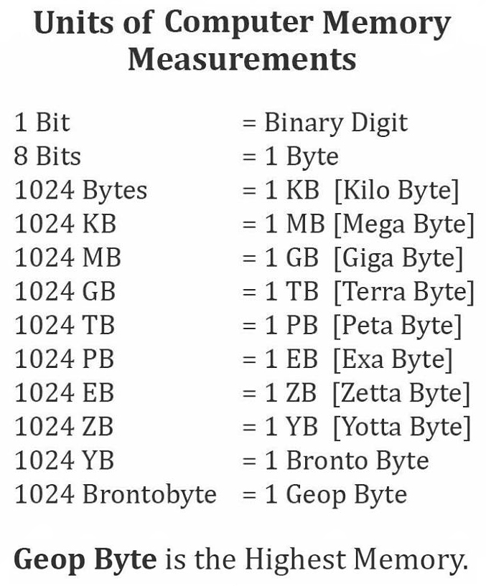
Computer - Memory Units
Memory unit is the amount of data that can be stored in the storage unit. This storage capacity is expressed in terms of Bytes.
S.No. | Unit & Description
1 | Bit (Binary Digit) A binary digit is logical 0 and 1 representing a passive or an active state of a component in an electric circuit.
2 | Nibble A group of 4 bits is called nibble.
3 | Byte A group of 8 bits is called byte. A byte is the smallest unit, which can represent a data item or a character.
4 | Word A computer word, like a byte, is a group of fixed number of bits processed as a unit, which varies from computer to computer but is fixed for each computer. The length of a computer word is called word-size or word length. It may be as small as 8 bits or may be as long as 96 bits. A computer stores the information in the form of computer words.

Slide 13
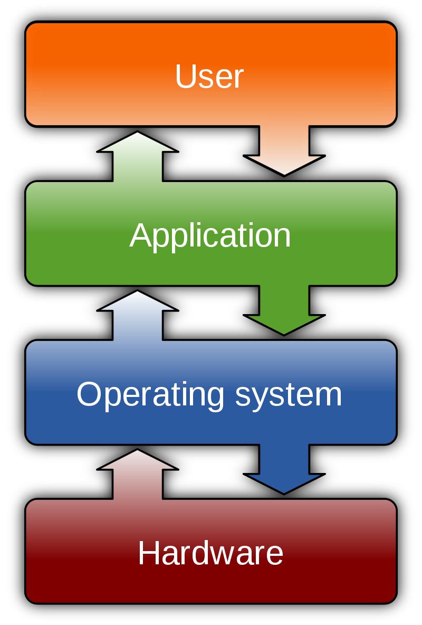
Relation between User and Hardware
User : A user is a person who utilizes a computer or network service
Application : Application software (app for short) is a program or group of programs designed for end users. E.g., WhatsApp, media player, file viewer etc.
Operating System : An Operating system (OS) is a software which acts as an interface between the end user and computer hardware
Hardware : Refers to the physical parts of a computer and related devices. Internal hardware devices include motherboards, hard drives, and RAM. External hardware devices include monitors, keyboards, mouse, printers, and scanners.

Slide 14
32-bit vs. 64-bit Processing -CPU
Current computing have two type processor i.e., 32-bit and 64-bit. These processor tells us how much memory a processor can have access from a CPU register.
For instance,
A 32-bit system can access 2³² memory addresses, i.e 4 GB of RAM or physical memory.
A 64-bit system can access 2⁶⁴ memory addresses, i.e actually 18-Quintillion bytes of RAM. In short, any amount of memory greater than 4 GB can be easily handled by it.

Slide 15
32-bit CPU Processing – Data & Address
Most computers made in the 1990s and early 2000s were 32-bit machines.
The CPU register stores memory addresses, which is how the processor accesses data from RAM.
One bit in the register can reference an individual byte in memory, so a 32-bit system can address a maximum of 4 GB (4,294,967,296 bytes) of RAM.
The actual limit is often less around 3.5 GB, since part of the register is used to store other temporary values besides memory addresses.
Most computers released over the past two decades were built on a 32-bit architecture, hence most operating systems were designed to run on a 32-bit processor.

Slide 16
64-bit CPU Processing – Data & Address
A 64-bit register can theoretically reference 18,446,744,073,709,551,616 bytes, or 17,179,869,184 GB (16 exabytes) of memory.
This is several million times more than an average workstation would need to access.
What’s important is that a 64-bit computer (which means it has a 64-bit processor) can access more than 4 GB of RAM.
If a computer has 8 GB of RAM, it better have a 64-bit processor. Otherwise, at least 4 GB of the memory will be inaccessible by the CPU.

Slide 17
32-bit vs. 64-bit CPU Processing
A major difference between 32-bit processors and 64-bit processors is the number of calculations per second they can perform, which affects the speed at which they can complete tasks.
64-bit processors can come in dual core, quad core, Hexa core and Octa core versions for home computing.
Multiple cores allow for an increased number of calculations per second that can be performed, which can increase the processing power and help make a computer run faster.
Software programs that require many calculations to function smoothly can operate faster and more efficiently on the multi-core 64-bit processors, for the most part.
Notes:
Ideally, these processors are suitable for multitasking due to the larger number of cores.
Each of the cores in a multi core processor, whether it is quad core, hexa-core or octa core processor, is dedicated to do different tasks.
It is this division of workload that makes the processors work much more efficiently as compared to other processors that do not have multi-core features.
This means that in a multi-core processor the cores will perform differently such as:
One core of the processor may be operating your call
Another doing the needful to open a website
A third one helping you in playing games or listening to music and so on.
All these jobs done at the same time will make your computer system work more efficiently.

Slide 18
CPU OPERATION
The fundamental operation of most CPUs is to execute a sequence of stored instructions called a program.
The program is represented by a series of numbers that are kept in some kind of computer memory.
There are four steps that nearly all CPUs use in their operation: fetch, decode, execute, and write back.

